Slide 1
Chapter 5
Some Discrete Probability Distributions
Chapter 5
Some Discrete Probability Distributions
Acknowledgment: Erwin Sitompul
PBST 6/1

Slide 2
Poisson Distribution and Poisson Process
Chapter 5.6
Poisson Distribution and Poisson Process
Experiments yielding numerical values of a random variable X, the number of outcomes occurring during a given time interval or in a specified region, are called Poisson experiments.
The time interval may be given in any length, such as minute, day, week, and month.
The specified region may be a line segment, an area, a volume, or
a piece of material

Slide 3
Properties of Poisson Process
Chapter 5.6
Poisson Distribution and Poisson Process
A Poisson experiment is derived from the Poisson process and
possesses the following properties:
The number of outcomes occurring in one time interval or specified region is independent of the number that occurs in any other disjoint time interval or region of space.
The probability that a single outcome will occur during a very short time interval or in a small region is proportional to the length of the time interval or the size of the region and does not depend on the number of outcomes occurring outside this time interval or region.
The probability that more than one outcome will occur in such a
short time interval or fall in such a small region is negligible

Slide 4
Poisson Distribution and Poisson Process
Chapter 5.6 Poisson Distribution and Poisson Process
|Poisson Distribution| The probability distribution of the Poisson random variable X, representing the number of outcomes occurring in a given time interval or specified region denoted by t, is
e ^{− λ t} (λ t ) ^{x}
p ( x; λ t ) =
, x = 0,1, 2,...
x !
where λ is the average number of outcomes per unit time or region, and e = 2.71828.... (natural number).
The mean and variance of the Poisson distribution p(x;λt) both
have the value λt.

Slide 5

Poisson Distribution and Poisson Process
Chapter 5.6 Poisson Distribution and Poisson Process
During a laboratory experiment the average number of radioactive particles passing through a counter in 1 millisecond is 4. What is the probability that 6 particles enter the counter in a given millisecond?
x = 6, λ t = 4
p (6; 4) =
e ⁻⁴ (4)⁶
= 0 .1042
6!
Ten is the average number of oil tankers arriving each day at a certain port city. The facilities at the port can handle at most 15 tankers per day. What is the probability that on a given day tankers have to be turned away?
15
P ( X > 15) = 1 − P ( X ≤ 15) = 1 − ∑ p ( x;10 )
x = 0
Table A.2 gives help
⎧ e ⁻ ¹⁰ (10 )¹
e ⁻ ¹⁰ (10 ) ²
_{e} − 10 ₍₁₀ ₎15 ⎫
= 1 − ⎨
⎩
+
+ +
⎬
⎭
1!
2 !
15 !
= 1 − 0 .9513
=
0 .0487

Slide 6
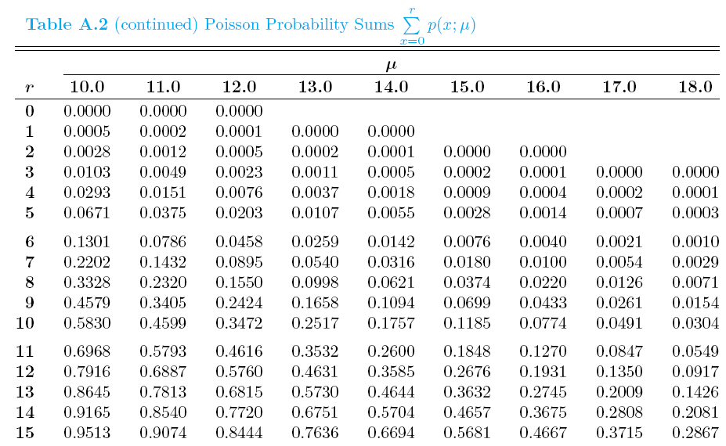


Table A.2 Poisson Probability Sums
Chapter 5.6 Poisson Distribution and Poisson Process

Slide 7
Poisson Distribution As a Limit of Binomial
Chapter 5.6 Poisson Distribution and Poisson Process
It should be clear from the three properties of the Poisson process
that the Poisson distribution relates to the binomial distribution.
In the case of the binomial, if n is quite large and p is small, the conditions begin to simulate the continuous space or time region implications of the Poisson process.
Poisson distribution can be taken as a limiting form of the binomial
distribution when n → ∞ and p → 0, and np remains constant.
If the conditions are fulfilled, the Poisson distribution can be used with μ = np, to approximate binomial distribution.
Let X be a binomial random variable with probability distribution
b(x;n,p). When n → ∞ and p → 0, and μ = np remains constant,
b ( x; n, p ) → p ( x, μ )

Slide 8
Poisson Distribution and Poisson Process
Chapter 5.6 Poisson Distribution and Poisson Process
In a certain industrial facility accidents occur infrequently. It is known that the probability of an accident on any given day is 0.005 and accidents are independent of each other.
What is the probability that in any given period of 400 days there will be an accident on one day?
What is the probability that there are at most three days with an
accident?
x = 1, λ t = (0.005)( 400) = 2
(a)
e ⁻² ( 2)¹
Considered as Poisson process
Considered as Bernoulli process
p (1; 2) = = 0 .2707
1!
b (1; 400, 0.005) =
1
399
C (0.005) (0.095)
= 0 .2707
400 1
3 3
(b) P ( X ≤ 3) = ∑ p ( x; 2 ) = ∑
e ⁻ ² ( 2 ) ^{x}
= 0.8571
x = 0 x = 0
x !
P ( X ≤ 3) = ∑ b ( x; 400, 0 .005)
x = 0
3
=
0.8571

Slide 9
Poisson Distribution and Poisson Process
Chapter 5.6 Poisson Distribution and Poisson Process
In a manufacturing process where glass products are produced, defects or bubbles occur, occasionally rendering the piece undesirable for marketing. It is known that, on average, 1 in every 1000 of these items produced has one or more bubbles. What is the probability that a random sample of 8000 will yield fewer than 7 items possessing bubbles?
μ = (8000)(0.001) = 8
6
P ( X < 7 ) = ∑ b ( x; 8000, 0.001)
x = 0
6
≈ ∑ p ( x; 8) =
x = 0
0 .3134
Actually a problem for Binomial Distribution
Solved by approximation using Poisson Distribution

